Slide 1

HISTOPATHOLOGY ORAL CANCER DETECTION
INT 625 Internship 3
FINAL REVIEW
Team Members
1. Sree lakshmi A - E7321005
2. Prem Kumar K S - E7321013
3. Divya D - E7321010
4. Pavithran V - E7321014
Project Guide
Dr. S. Pitchumani Angayarkanni

Slide 2


HISTOPATHOLOGY ORAL CANCER DETECTION

Slide 3



Introduction
Histopathology is a field of medicine that involves the microscopic examination of tissue samples to diagnose diseases. Oral cancer is a type of cancer that affects the tissues of the mouth and throat, and histopathology is a critical tool in its detection and diagnosis. By analyzing tissue samples, histopathologists can identify the presence of cancerous cells, determine the stage of the disease, and guide treatment decisions.
However, histopathology can help identify the presence of abnormal or cancerous cells in tissue samples taken from the mouth.
By using deep learning algorithms, histopathologists can automate the analysis of large, complex tissue samples and accurately identify

Slide 4




Problem statement/Objectives
How Deep Learning can help Oral cancer Detection?
Oral cancer is a significant health problem worldwide, and it is the sixth most common cancer. Early detection of oral cancer can significantly improve the chances of successful treatment and patient survival.
The problem statement for histopathology oral cancer detection using deep learning is to develop a deep learning-based model that can accurately and reliably detect and classify oral cancer in histopathology images. The model should be able to differentiate oral cancer or Not with a large dataset of histopathology images.

Slide 5

Review of Literature
SNO | PUBLICATIONS | DATASET TYPE | METHODS | ACCURACY | FINDINGS
[1] | Shams w.k.et al.[2016] | Gene Expression | DNN | 86% | Slide 6
[2] | H.Alkhadar [2020] | Clinical and histopathological | Decision Tree | 76% | Slide 6
[3] | V.Shavlokhova [2021] | Histopathological | CNN | 77.89% | Slide 6
[4] | H.Aberville [2017] | Laserendomicroscopy | Deep Learning | 80.01% | Slide 6

Slide 6

Investigated using machine learning techniques with gene expression profiling to predict the possibility of oral cancer development in OPL patients.
Machine learning analyses of cancer outcomes for oral cancer remain sparse compared to other types of cancer like breast or lung. The purpose of the present study was to compare the performance of machine learning algorithms in the prediction of global, recurrence-free five-year survival in oral cancer patients based on clinical and histopathological data.
In this preliminary work, we trained a CNN model on a limited number of ex vivo FCM images and obtained promising results in the automated classification of cancerous tissue. Further studies using large sample, sizes are warranted to introduce this technology into clinics.
Evaluated a novel automatic approach for OSCC diagnosis using deep learning technologies on CLE images. The method is compared against textural feature-based machine learning approaches that represent the current state of the art.

Slide 7

REFERENCES:
Shams WK, Htike ZZ. Oral cancer prediction using gene expression profiling and machine learning. Int J Appl Eng Res 2017; 12: 4893-8.
Alkhadar H., Macluskey M., White S., Ellis I., Gardner A. Comparison of machine learning algorithms for the prediction of five-year survival in oral squamous cell carcinoma. J. Oral Pathol. Med. 2021;50:378–384. doi: 10.1111/jop.13135. [PubMed] [CrossRef] [Google Scholar]
Shavlokhova V., Sandhu S., Flechtenmacher C., Koveshazi I., Neumeier F., Padrón-Laso V., Jonke Ž., Saravi B., Vollmer M., Vollmer A., et al. Deep Learning on Oral Squamous Cell Carcinoma Ex Vivo Fluorescent Confocal Microscopy Data: A Feasibility Study. J. Clin. Med. 2021;10:5326. doi: 10.3390/jcm10225326. [PMC free article] [PubMed] [CrossRef] [Google Scholar]
Aubreville M., Knipfer C., Oetter N., Jaremenko C., Rodner E., Denzler J., Bohr C., Neumann H., Stelzle F., Maier A. Automatic Classification of Cancerous Tissue in Laserendomicroscopy Images of the Oral Cavity using Deep Learning. Sci. Rep. 2017;7:11979. doi: 10.1038/s41598-017-12320-8. [PMC free article] [PubMed] [CrossRef] [Google Scholar]

Slide 8

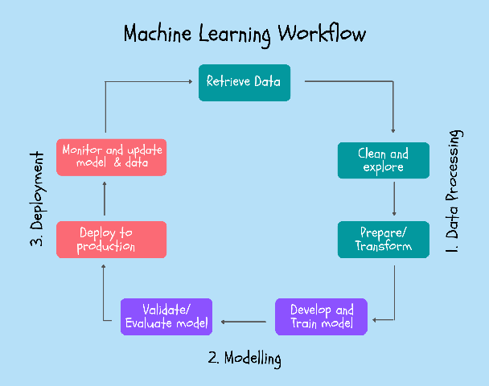
Work Flow
1
Data preparation
4
Train the model
Collection of dataset for the model
model learns to recognize patterns in the data
2
Data pre-processing
Hyperparameter tuning
5
Preparing the image data
tain ,test,val
cropping
augmenting
such as the learning rate or number of layers, to improve its performance
3
Model selection
6
Deploy the model
deep learning architecture
Vgg 16
Renet 50
After testing the model deploying it for the Real-time access
Notes:
Data collection: Collecting a large dataset of labeled images that will be used for training the deep learning model.
Data pre-processing: Preparing the image data for use in training the model, which may include resizing, cropping, normalizing, or augmenting the images.
Model selection: Choosing the appropriate deep learning architecture, such as convolutional neural networks (CNNs), that is suitable for the task at hand.
Training the model: Training the deep learning model using the prepared image data, which involves forward propagation and backpropagation of errors to adjust the model's weights.
Model evaluation: Evaluating the performance of the model on a validation dataset to assess its accuracy and other metrics.
Hyperparameter tuning: Tweaking the model's hyperparameters, such as the learning rate or number of layers, to improve its performance.
Test the model: Using a test dataset to validate the performance of the model on unseen data.
Deploy the model: Deploying the trained model for use in real-world applications, which may involve integrating it into an existing software system or creating an API for other applications to use.

Slide 9


Data preparation
Download and extract the dataset files from Kaggle.
Perform data cleaning to remove any corrupted or invalid data.
Normalize the image pixel values to a common scale to improve model training and reduce bias.
Augment the dataset by applying transformations to the images such as rotation, flipping, or zooming to increase the dataset's size and improve model robustness.
Annotate the images to identify regions of interest or label the images according to the presence or absence of cancer. This annotation process can be done manually or through automated tools.

Slide 10
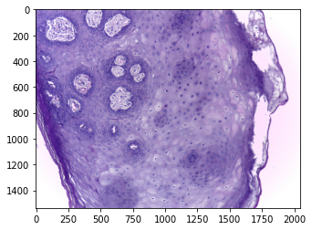
observed
Dataset Size - 2.97 GB
Contains 3 main folders train test val
Normal and OSCC
Dataset contains 5192 JPG files.
OSCC - Oral squamous cell carcinoma

Slide 11
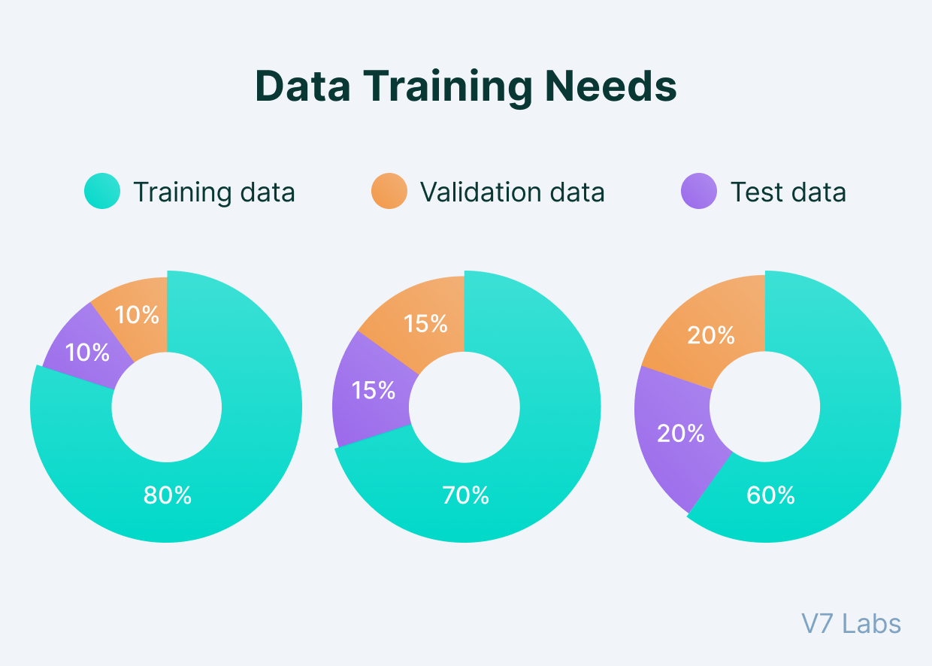

Data pre processing
Split the dataset into training, validation, and testing subsets to evaluate the performance of the machine learning models accurately.
Verify that the dataset is balanced and representative
of the target population to reduce potential bias and
improve model generalization.
Image normalization
Image augmentation
Image datagenerator

Slide 12
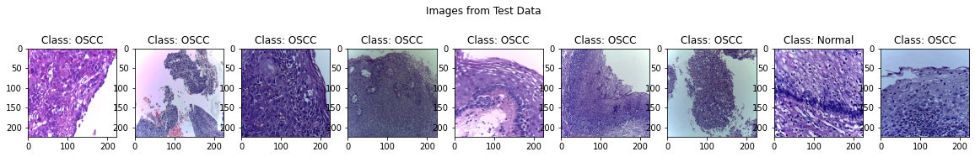
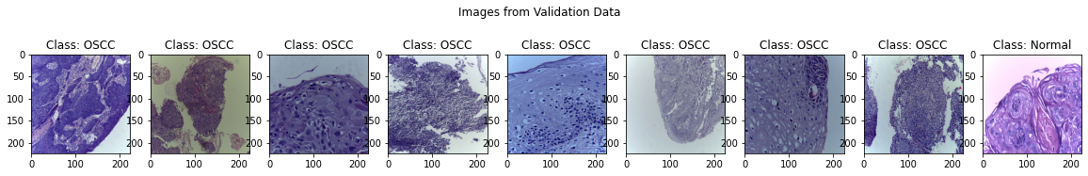
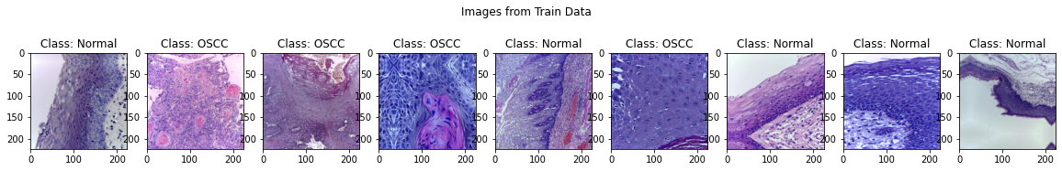
Images in Datagenerator

Slide 13

Model Selection
CNN
Convolutional Neural Networks
Deep learning Model
RNN
Recurrent Neural Networks
GAN
Generative Adversarial Networks
Autoencoders
encoding an input image into a lower-dimensional representation

Slide 14
CNN Model
01
02
Traditional CNN model
Pre-trained CNN model
Trained from the Scratch
already been trained on a large dataset

Slide 15

Pre-trained CNN model
VGG16 and VGG19: These models were developed by the Visual Geometry Group at the University of Oxford and are named after the number of layers they have (16 and 19, respectively). They consist of a series of convolutional and pooling layers followed by a few fully connected layers.
ResNet: ResNet stands for "Residual Network" and was developed by Microsoft Research. It uses a residual architecture that allows for very deep networks without causing the vanishing gradient problem.
InceptionNet/GoogLeNet: InceptionNet, also known as GoogLeNet, was developed by Google and won the 2014 ImageNet competition. It uses "inception modules" that allow for parallel processing of the input data.
MobileNet: MobileNet was developed by Google and is designed for mobile and embedded devices. It uses depth-wise separable convolutions to reduce the number of parameters and computations required.

Slide 16
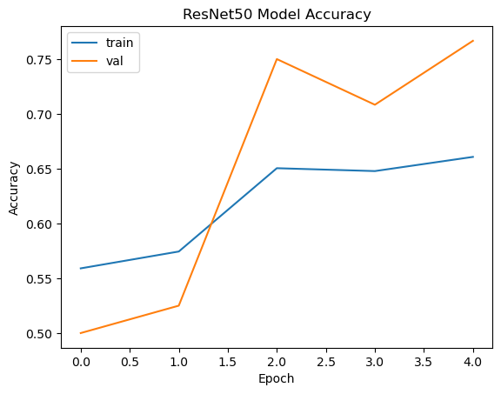
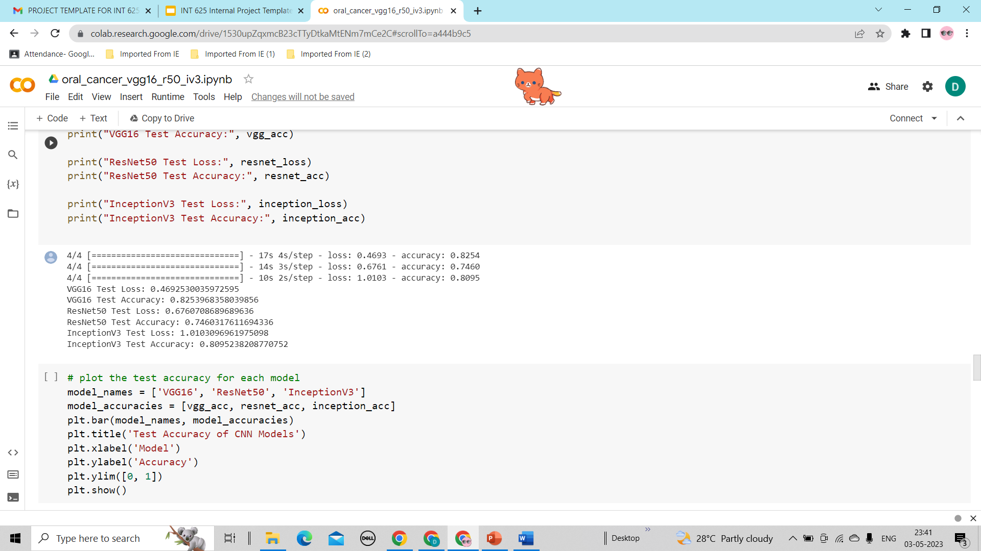
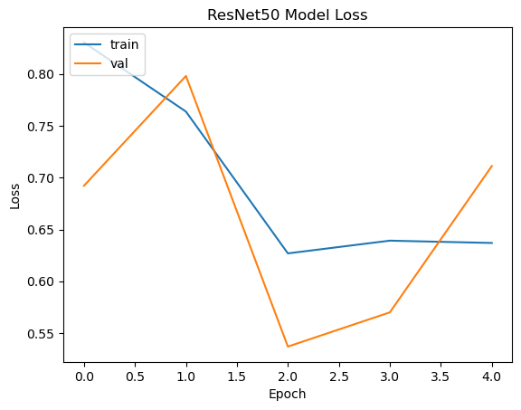
ResNet 50
Here we can observe that , for ResNet50 we got accuracy as 74% and 67% test loss

Slide 17
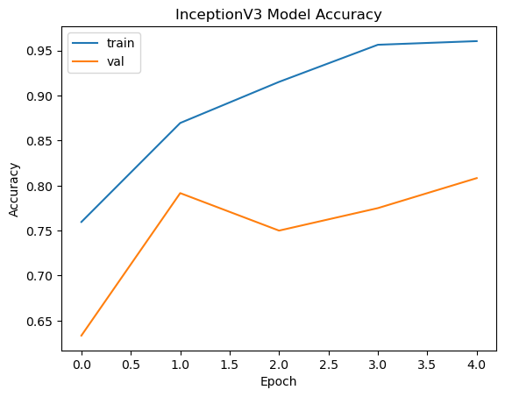
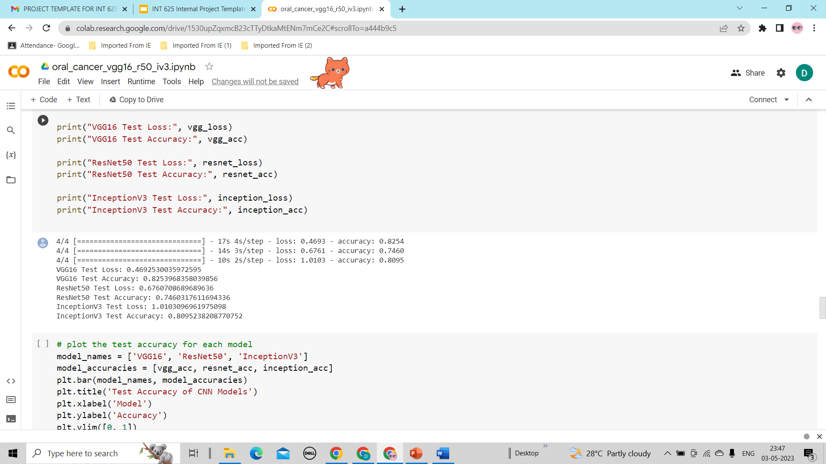
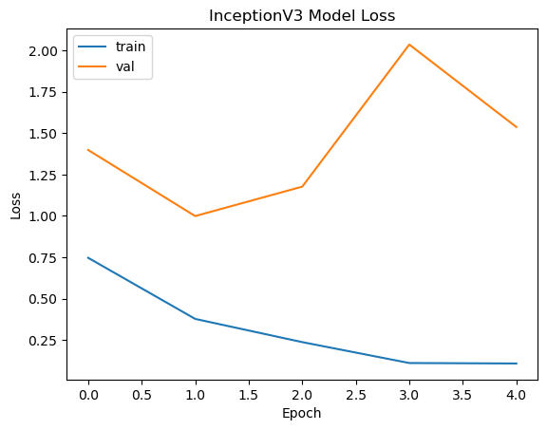
INCEPTION V3
Here we can observe that , for InceptionV3 we got accuracy as 80%.

Slide 18
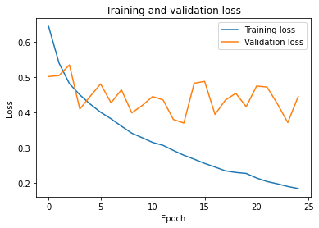
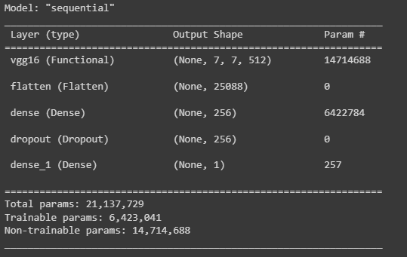
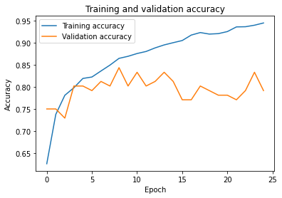

VGG 16

Slide 19
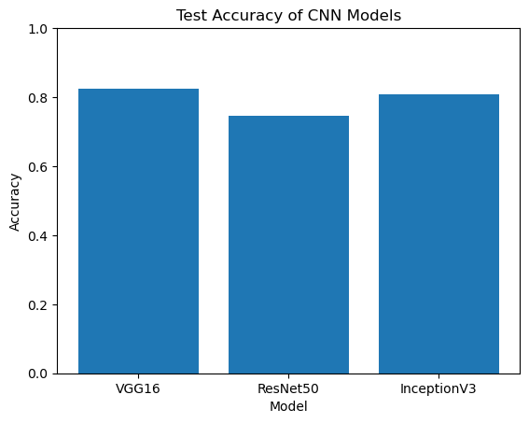
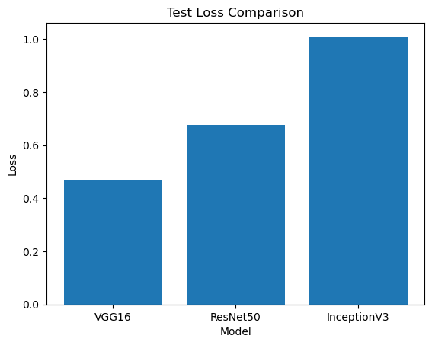
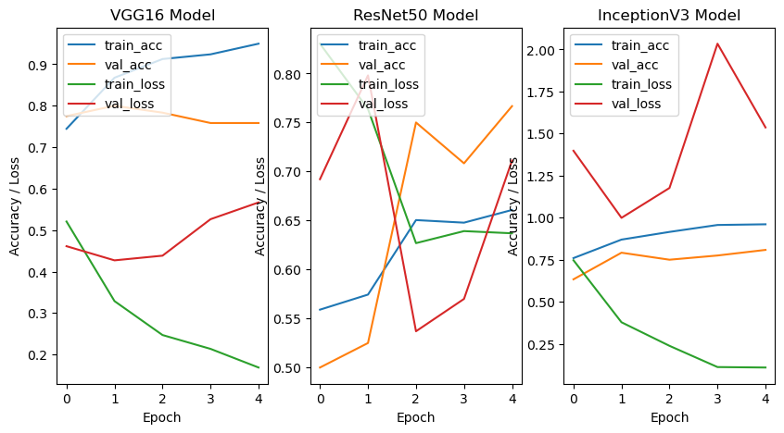
MODEL COMPARISON

Slide 20
Machine Learning Infographics
Inputs
Outputs
OSCC
OSCC

Slide 21
CONCLUSION
Deep learning-based histopathology analysis has shown promising results in the detection of oral cancer. By leveraging the power of deep neural networks, researchers have been able to develop robust and accurate models for analysing histopathological images and identifying cancerous cells or tissues.
While comparing VGG16,ResNet50 and InceptionV3 it is observed that VGG16 pre-trained model performed well with 83% accuracy. The ultimate objective in Oral cancer detection is to develop a high accuracy model that is effective and affordable.

Slide 22
FUTURE ENHANCEMENT
In the future work, we will continue to propose more efficient and rapid methods for Oral cancer recognition. The target is to realize multi-class recognition of oral cancer based on the research of benign and malignant tumour recognition. In addition to improving the recognition accuracy, we also hope to extract more effective information about cancer, which can help doctors find the lesion faster and reduce the workload on doctors.

Slide 23
WORKLOG
Date | Duration in Hrs. | Task Planned | Task Completed | Description of the Task | Scope of the task | Skills Acquired
01.03.2023 - 02.03.2023 | 12 hours | Abstract | Completed | Referring to the concept about the given dataset | Abstract done | Understanding the dataset
04.03.2023 - 09.03.2023 | 30 hours | Exploring the dataset | Completed | Exploring the dataset in different platforms. | Dataset Found | Anayzing the dataset
11.03.2023 - 15.03.2023 | 36 hours | Learning about oral cancer histopathology | Completed | Studying about histopathology, different types of level and more | Got some knowledge about histopathology | Learning About the histopathology
27.03.2023 | 6 hours | PPT - 1 | Completed | Creating a ppt based on the completed task Literature review | Finalizing a better ppt | Power point tools
28.03.2022 - 30.03.2023 | 30 hours | Data Preparation | Completed | Collection of dataset for the model | Properly oragnised the Dataset | using image datagenerataor
04.04.2023 | 6 hours | Model Selection | Completed | selecting model for image dataset | selecting the CNN model | deep learning python
06.04.2023 - 08.04.2023 | 18 hours | Model training | Completed | Training the selected model | To Analyze the Model | Model training python deep learning architecture
10.04.2023 - 13.04.2023 | 14 hours | Hyperparameter tuning | Completed | optimizing the hyperparameters of the model | To improve Model performance. | Optimization techniques

Slide 24
THANK YOU

